Slide 1
Data Management Examination 2021-Goal A
-Bina Khatnani(11015617)

Slide 2
Tools & Technology
Data Profiling-Talend
Data Cleaning-Open Refine

Slide 3
User Story & Requirements
As a transfer pricing analyst, I wants to analyse different companies benchmarking and Arms Length Indicator within the sector and determine the additional cost validation of the company.
E.g., I want to determine if Infosys falls under tax jurisdiction or not
Financial year must be 31st of March of the following year.
Negative values percentage cannot be considered.
Companies incorporated after 2011 is not be considered.
The benchmarking is to be carried out for year 2016, I want arms length for at least 1 year and maximum 4 years.
Maximum 100 company's arms length indicator and additional cost analysis within that sector for the financial year.

Slide 4
Data Set & Meta Data
The transfer pricing data set has 26,373 rows and 16 columns. 2 columns are derived after cleaning the dataset.
Serial Number as S.I No. -Integer
Company Name –String
Financial Year-Date
Ownership Type-String
Incorporation year-Integer
Sales total revenue-Float
DICOP(Direct Indirect cost of production)-Float
VAE(Value added expenditure)-Float
OP(Operating Profit)-Float
Total Cost-Integer
Gross Profit-Integer
Arms Length Indicator-Float
Other Operating Income or sales-Integer
Advertising and Marketing sales-Integer
Additional Cost –Integer(derived)
Final Results-Boolean(derived)

Slide 5
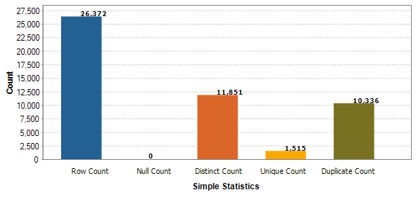
Serial Number
Analysis and Cleaning
Serial Number is not unique in the dataset.
A unique serial number across all the rows is implemented to overcome duplicate count issue .
Function used to overcome duplicity is “00000”[0,5-row.index.length()]+row. Index
This cleaning is required as the user wants to knows how many companies has to be analysed(Requirement 1).
Dimensions used are Uniqueness.
Diagram 1 .Data Profiling for Serial Number from Talend

Slide 6
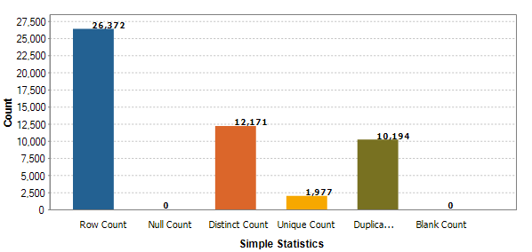
Company Name
Analysis and Cleaning
Company Name has 10,194 duplicate records but that is in accordance with the business rules(Requirement 2).
A company’s name cannot repeat fifth time because a company name is to be evaluated for consequent four years only.
Text facet and clustering are performed to ensure no duplicate records for company’s name.
Dimensions used are Conformity.
Diagram 2.Data Profiling for Company name from Talend

Slide 7
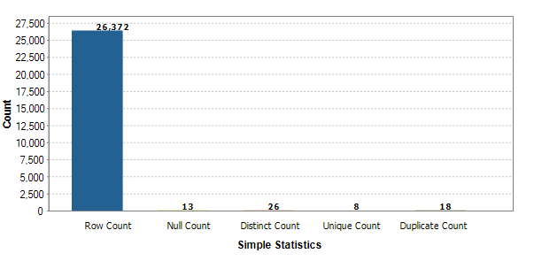
Financial Year
Analysis and Cleaning
Financial Year has 26 distinct counts but it should be four(Requirement 5).
A Financial year has to be as of 31st of the march of the following year as per the business rules and the dataset has data from 2012 to 2015.
The date was in integer format e.g. 201408,this integer is converted to string by using function value[0,4].A month 03 and a day 31st is made consistent throughout the column.
Dates has to be in date format. todate() is applied for the appropriate format.
Dimensions used are Validity, Accuracy and Consistency
Diagram 3.Data Profiling for Financial Year from Talend

Slide 8
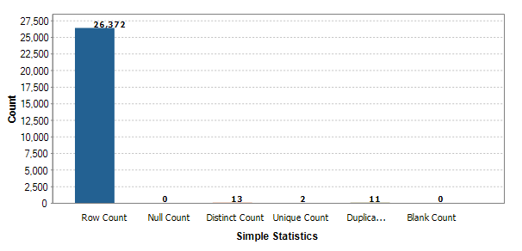
Ownership Type
Analysis and Cleaning
Ownership type has 11 duplicate counts and inaccurate values.
Ownership type has been corrected as per the relevant grouping(Requirement 1) and a confirmative check /Reconciliation is performed from the relevant source.
Dimensions used are Accuracy ,conformity and Consistency
Diagram 4.Data Profiling for Ownership Type from Talend
Ref-https://www.tofler.in/emerald-leasing-finance-and-investment-company-limited/company/L65993DL1983PLC016993

Slide 9
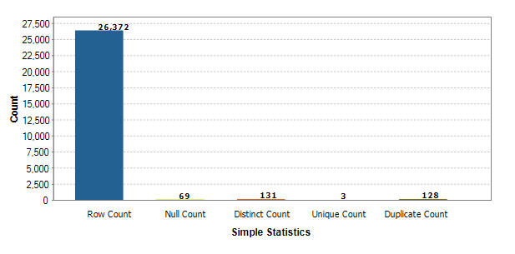
Incorporation Year
Analysis and Cleaning
Incorporation Year has 69 Null records and few invalid values.
Incorporation year has been corrected as per Requirement 3. Rows for the year 2012,2013,2014,2015,2016,2017 and 2018 is removed. Total 512 records are removed.
Missing value are obtained from the relevant source and this values were uploaded in Open refine as a Corporation Year project.
A lookup was performed between two projects and new column is added as Inkorporation Year.
Dimensions used are Accuracy, Conformity, Validity ,Completeness and Timeliness.
Diagram 5.Data Profiling for Incorporation Year from Talend
Ref-corporationyear - OpenRefine

Slide 10
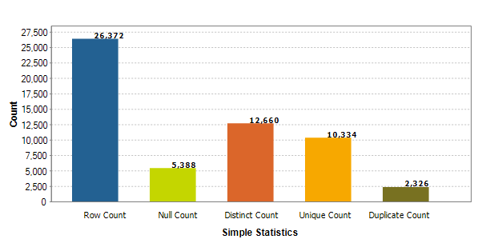
Sales-Total Revenue
Analysis and Cleaning
Sales has 5388 Null records, invalid datatype and inconsistency within the format(Requirement 4).
Null records are updated to 0.00000 and a formatting for the floating point values is performed to maintain the values in decimal points using value[0,7].
Dimensions used are consistency, validity and completeness.
Diagram 6.Data Profiling for Sales from Talend

Slide 11
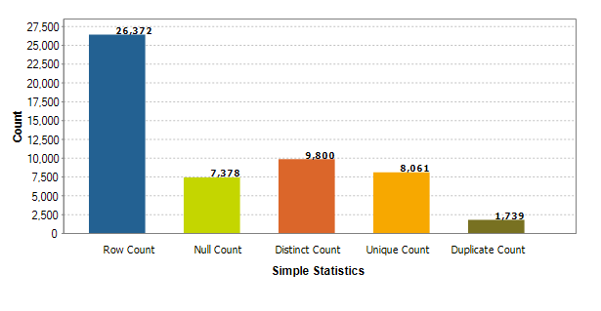
DICOP-Direct Indirect Cost of Production
Analysis and Cleaning
DICOP has 7378 Null records, invalid datatype and inconsistency within the format(Requirement 4).
Null records are updated to 0.00000 and a formatting for the floating point values is performed to maintain the values in decimal points using value[0,7].
Dimensions used are consistency, validity and completeness.
Diagram 7.Data Profiling for DICOP from Talend

Slide 12
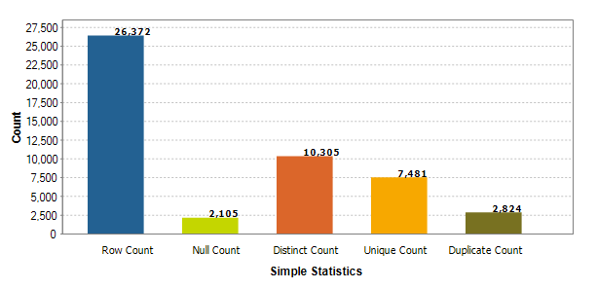
VAE-Value Added Expense
Analysis and Cleaning
VAE has 2105 Null records, invalid datatype and inconsistency within the format(Requirement 5).
Null records are updated to 0.00000 and a formatting for the floating point values is performed to maintain the values in decimal points using value[0,7].
Dimensions used are consistency, validity and completeness.
Diagram 8.Data Profiling for VAE from Talend

Slide 13
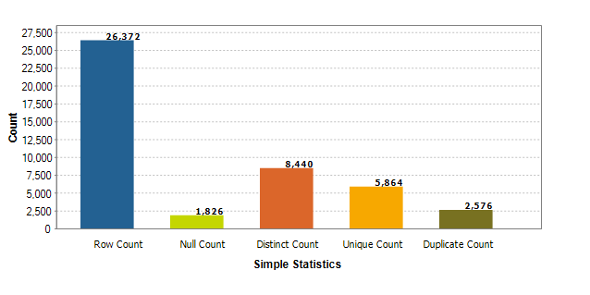
OP-Operating Profit
Analysis and Cleaning
OP has 2105 Null records, invalid datatype and inconsistency within the format .(Requirement 4).
Null records are updated to 0 and a formatting for the floating point values is performed to maintain the values in Integer. value.toString("%.0f")
Percentage cannot be negative hence -0 changed to 0.
Dimensions used are consistency, validity and completeness.
Diagram 9.Data Profiling for OP from Talend

Slide 14
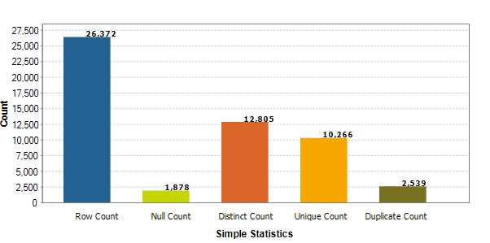
Total Cost
Analysis and Cleaning
Total Cost has 1878 Null records, invalid datatype and inconsistency within the format(Requirement 4).
Null records are updated to 0.00000 and a formatting for the floating point values is performed to maintain the values in decimal points using value[0,7].
Dimensions used are consistency, validity and completeness.
Diagram 10 .Data Profiling for Total cost from Talend

Slide 15
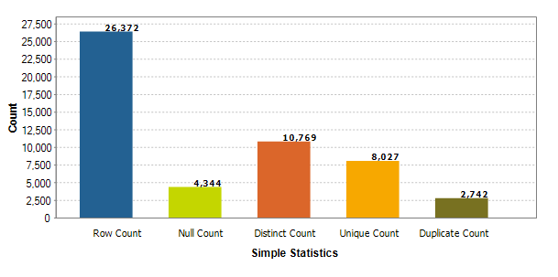
GP-Gross Profit
Analysis and Cleaning
GP has 4344 Null records, invalid datatype and inconsistency within the format(Requirement 4).
Null records are updated to 0 and a formatting for the floating points is performed to maintain the values in Integer value.toString("%.0f")
Percentage cannot be negative hence -0 changed to 0.
Dimensions used are consistency, validity and completeness.
Diagram 11.Data Profiling for GP from Talend

Slide 16
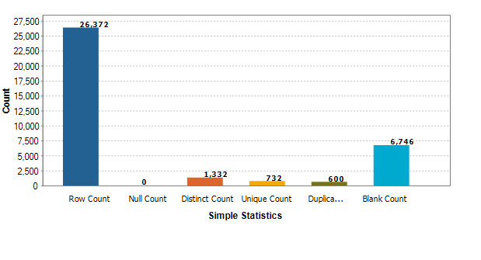
Arms Length Price-Transfer Price Indicator
Analysis and Cleaning
Arms Length price has 6746 blank records, invalid datatype and inconsistency within the format(Requirement 4).
Though Arms length price is a percentage, we will keep it in decimal to avoid missing of a company for fractional margin.
Null records are updated to 0.00000 and a formatting for the floating point values is performed to maintain the values in decimal points using value[0,7].
Dimensions used are consistency, validity and completeness.
Diagram 12.Data Profiling for Arms length price from Talend

Slide 17
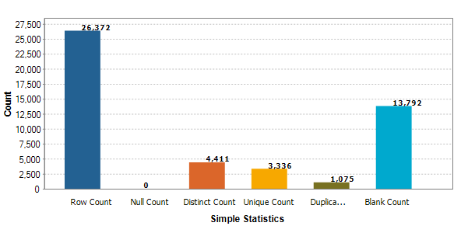
Other Operating Expense
Analysis and Cleaning
Other Operating Expense has 13792 blank records, invalid datatype and inconsistency within the format(Requirement 4).
Null records are filled to 0 and a formatting for the floating point values is performed to maintain the values in Integer using value.toString("%.0f")
Other operating expenses is a deriving column for Additional cost hence the data type changed to numeric using Value.toNumber()
Dimensions used are consistency, validity and completeness.
Diagram 13.Data Profiling for Other Operating Expense from Talend

Slide 18
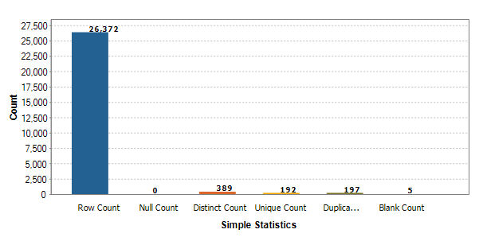
Advertising and Marketing cost
Analysis and Cleaning
Other Operating Expense has 5 blank records, invalid datatype and inconsistency within the format (Requirement 4).
Null records are updated to 0 and a formatting for the floating point values is performed to maintain the values in Integer. value.toString("%.0f")
Advertising and Marketing Cost is a deriving column for Additional cost hence the data type changed to numeric using Value.toNumber()
Dimensions used are consistency, validity and completeness.
Diagram 14.Data Profiling for advertising and Marketing Cost from Talend

Slide 19
Derived Columns
Additional Cost
Final Results
Additional cost is a derived column by summing up Other operating Expense and Adv & Mkt cost.
The sum is achieved by cells['Other Operating Income/Sales'].value + cells['Advertising & Marketing Sales'].value
This Column is calculated to check if the companies additional cost is greater than 0 and whether they can participate in consideration for Arms Length Price(USER STORY).
Final Results is a derived column from Additional cost
If the value of the company's additional cost is greater than 0 then the company can participate in determine tax judication of the evaluating company.
To derive this condition , below conditional statement is used. value.toNumber() > 0, "True", "False“.

Slide 20
Q & A.
What insights did you gain from this dataset profiling and cleaning?
Does my data makes sense?
Can I consider my data for data modelling?
Does my data have enough quality after cleaning?
Does my data is helping me to know the functional dependency?
Which all data quality dimension does your analysis fits into?-Explain the dimension with a user-story, the user-story can be hypothetical one created by you?
Explained on slide 5-19 for each variable and the quality dimensions considered with the relevance of the user story.

Slide 21
Q & A.
Why did you choose a given technique and the associated steps for a task? - Is there an alternative technique that could have been?
There could have been alternative tool used for the data cleaning for e.g. Trifecta. But, the approach for the cleaning has to be in similar fashion. Since, Transfer pricing is a known practice in Big 4’s and same cleaning steps are considered while cleaning a database for transfer pricing.

